Slide 1

WELCOME
TO
AGE-FRIENDLY STRATEGIES
FOR
NURSING HOME CNA’S
MODULE 4

Slide 2




Funding Disclosures
This project is/was supported by the Health Resources and Services Administration (HRSA) of the U.S. Department of Health and Human Services (HHS) under grant number U1QHP28740, Geriatrics Workforce Enhancement Program for $3.5 million. This information or content and conclusions are those of the author and should not be construed as the official position or policy or, nor should any endorsements be inferred by, HRSA, HHS or the U.S. Government.
Notes:
This slide shows that we have funding from HRSA, part of Health and Human Services and the program is called GWEP.
We are partnered with the Keck School of Medicine, Department of Family Medicine, Alzheimer’s Los Angeles and the modules we are teaching today are based on work from Weill Cornell.

Slide 3


IDEA! Review
WHAT IDEA! STRATEGIES DID YOU TRY?
DID ANYTHING SURPRISE YOU ABOUT WHAT YOU LEARNED?
Notes:
Let’s review what we learned in our last training together: (Ask questions above)
5 minute discussion
Identify the behavior
Explore the cause and meaning
Adjusting to solve the problem

Slide 4

CARE MATTERS!
A NURSING HOME CNA TOOLKIT FOR WORKING WITH RESIDENTS
FROM DIVERSE CULTURAL BACKGROUNDS
Presented By:
Date:

Slide 5
WHY IS CROSS-CULTURE CARE IMPORTANT?
Each of us has a cultural and ethnic background
Ethnic and cultural differences between residents and staff is common
Many residents spent their younger years in more segregated situations
This may be residents' first experience with people who are different from themselves
It may also be the first time a resident is dependent on people who are different from themselves

Slide 6
CARE MATTERS! TOOL KIT
CARE Matters! is a practical CNA toolkit to help CNAs figure out
what they can do to improve care and communication with residents from different racial, ethnic, or cultural backgrounds.
Curiosity
Awareness
Root out bias
Empathy
Notes:
1) Gain knowledge about cultural insights.
2) Learn cross-cultural communication skills needed to identify with residents’ feelings around their cultural upbringing.
3) Experience empathy with residents from different cultural backgrounds that will help staff provide the best and most culturally sensitive possible care.

Slide 7
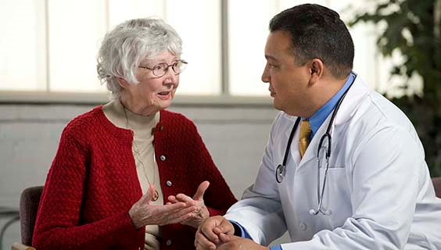
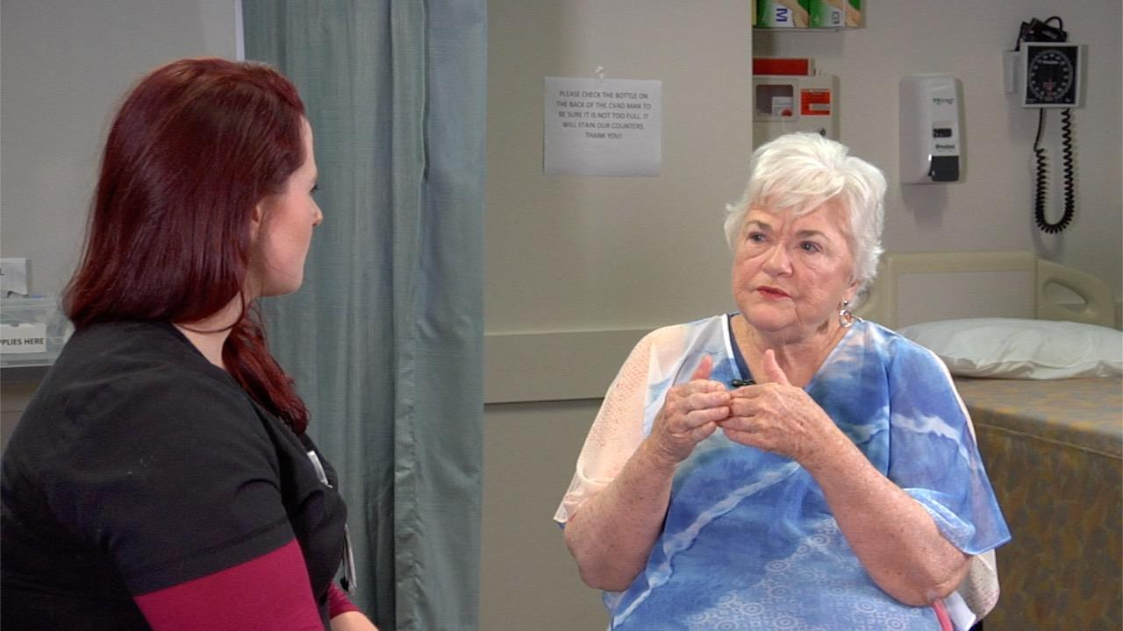
CURIOSITY
“ Every provider-patient encounter is a cross-cultural exercise—even
if the they grew up on the same street in the same small town”
- Brody and Hunt 2005

Slide 8

CURIOSITY
Who am I?
List your identities
Next, let’s write them out
Let’s discuss
Notes:
People come in all shapes, sizes, nationalities, and races. These identities make up an important part of who we are. In fact, one of your most important assets as a caregiver is our sense of identity. Identity can mean any of the many ways we see ourselves, whether it’s culture, ethnicity, geographic area, or age. Sharing our cultural identity is one of the ways we can contribute to our nursing home. First, let’s brainstorm what we mean by identity, so we can understand the idea a little better.
Ask the group to generate a list of identities and call them out- Next, reflect and discuss the list (5 mins)
So, you see, there are many different forms that our cultures and identities might take. The same goes for residents that you work with every day.

Slide 9
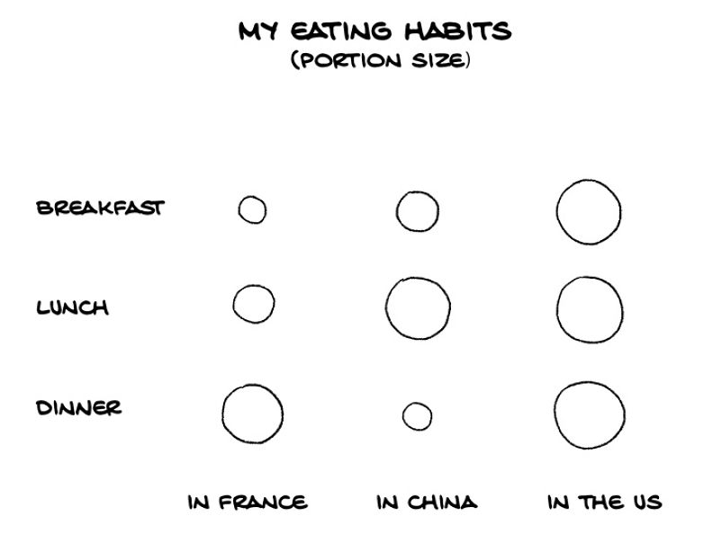
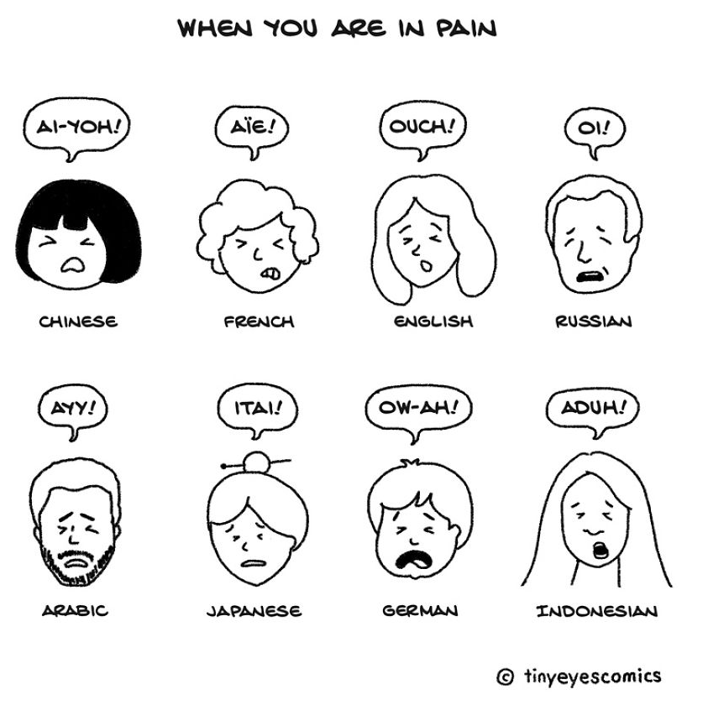
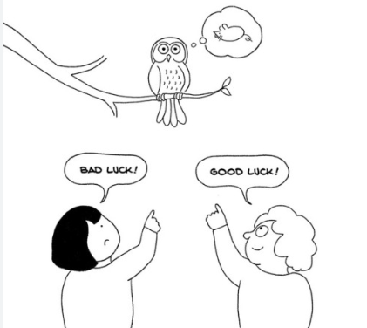
HOW MIGHT CULTURE IMPACT OUR CARE PREFERENCE?
Lifestyle Preferences
Communication Styles
Health
Beliefs and Practices

Slide 10

CURIOSITY
Cultural Background of Residents
Let’s take a minute to think about your residents and their cultural background.
What are some ways you have learned about their cultures?
Notes:
Trainer: Ask volunteers to describe strategies and share some responses
Trainer: Write the key words/ responses on a flipchart or white board; and try linking to some of the techniques that we will introduce in the next slide, including:
ask questions
be observant
consider yourself both teacher and learner at the same time

Slide 11

PRACTICING CULTURAL CURIOSITY
Ask questions:
“What matters?”
“What is important to you?”
“Tell me more about this photo!”
Be observant:
There are things you can learn
by observing your residents

Slide 12
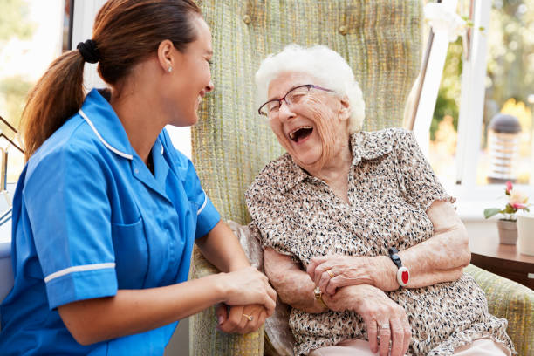
PRACTICING CULTURAL CURIOSITY
Consider yourself to be
both teacher and learner
of one’s culture!
Everyone is the master
of one’s own culture
Learn about the personal
history of the resident

Slide 13
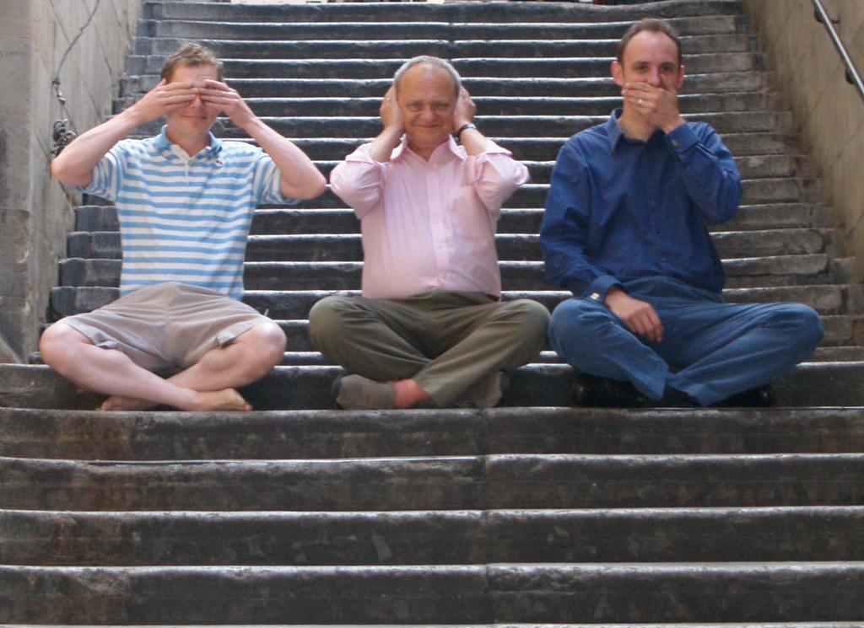
AWARENESS
“Biases are the stories we made up about people before we know who they actually are.” -
Verna Myers

Slide 14



AWARENESS
What are bias, prejudice, and discrimination?
Bias: An attitude of feeling about a specific group
Stereotype: A thought that is generalized about a specific group
Discrimination: A behavior based on biased attitudes
Notes:
Stereotype: we have deep-rooted beliefs about certain groups, which is usually informed by culture. Like in Zootopia- the fox and bunny cop characters have preset ideas about one another “sly fox” or “dumb bunny”.
Discrimination: a behavior that makes the target feel singled out

Slide 15
AWARENESS
Exercise: Think & Share
Think about a time when you have experienced bias in the forms we discussed?
How did you feel? What did you wish could be different?
Notes:
What if I experience bias all the time?
Personally, at work- Trainer to give an example/ share your experience

Slide 16

PRACTICE AWARENESS
Stop what you're doing.
Take some slow, deep breaths.
Observe your thoughts, feelings, and assumptions.
Proceed with resident care
Notes:
Let’s try it now (1 min)

Slide 17
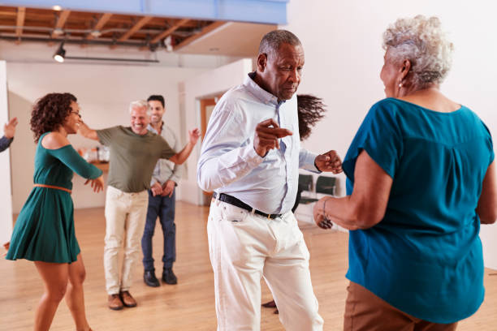
ROOT-OUT BIAS
“Diversity is being invited to the party; inclusion is being asked to dance.”
–Verna Myers

Slide 18
ROOT-OUT-BIAS
Why is it important to confront bias?
Grow a sense of community
Improve our well-being
Improve care quality
Make our workplace safe

Slide 19

PRACTICE ROOTING-OUT-BIAS
Who is the individual? Learn
about the personal history of
the individual
Challenge stereotypes by thinking about people who counter those stereotypes or images
We are equals in building this care partnership

Slide 20

EMPATHY
“I’ve learned that people will forget what you said, people will forget what you did, but people will never forget how you made them feel.”
-- Maya Angelou

Slide 21
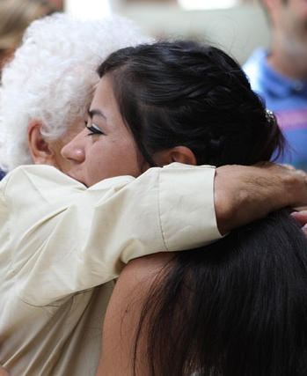
EMPATHY
Empathy is the ability to put yourself in someone else's shoes.
It is about how to listen, connect, and respond.
Notes:
I'm sure that you are already good listeners. Next, I'll share with you some information that will help you become even better at listening to your residents' and their family members. These skills may also help you communicate better with other people in your life-- your spouse or partner, your children, and your friends.

Slide 22
EMPATHY: COMMUNICATION HELPERS VS. BLOCKERS
HELPERS
Door openers
  You sound upset. Would you like to talk about it?
Showing support
  I’m here for you. Let’s work together
Showing worry
  I am worried about you. You look you are in pain. How can I help you?
Showing acknowledgement
  This has been hard for you.
Validation
  I understand. Most people would feel the way you do.
BLOCKERS
Blaming
  It’s your fault that you don’t tell the doctor what you need
“Always” and “Never”
  You always complain and never cooperate with me!
Name-calling
  That aid is really stupid if she doesn’t know about your culture
Labeling
  That resident is such a typical rich person--she only cares about her money
Giving orders or threatening
  If you don’t move from your chair, then I am going to walk away now

Slide 23
PRACTICE EMPATHY
Can anyone give an example of an experience with a communication blocker?
How did it feel? How did it affect your communication with that person?
What if they had instead used a communication helper? How would that have changed your conversation?
Notes:
How did that affect your willingness to communicate with that person?
Then ask, If the other person had used any of the Communication Helpers instead, how would that have changed your interaction?

Slide 24
CARE MATTERS! IN ACTION
Use CARE Matters when you are working with a resident from a different background next time (e.g., culture, race, ethnicity, gender, religion, sexual orientation)
Remember the 4 steps
Curiosity Strike a conversation Tell me what matters? Awareness of assumption and biases Use Stop Root out bias Counter stereotypes and build partnerships Empathy Use empathic communication helpers; avoid blockers

Slide 25

CARE MATTERS! PRACTICE
Think about how CARE Matters! techniques can help you with communication problems that come from cultural or ethnic differences.

Slide 26




THANK YOU!
Notes:
This is the last session of this four-part training we hope that you have learned some new ideas and that you can use them every day to be more effective at work and feel good about the important work you do.
On behalf of the research team at USC, Weill Cornell and in collaboration with Wise & Healthy Aging, Alzheimer’s LA, and Age-Friendly Health Systems we thank you for your time and effort in joining us for this learning experience.

