Slide 1

WELCOME
TO
AGE-FRIENDLY STRATEGIES
FOR
NURSING HOME CNA’S
MODULE 3
‹#›
Notes:
‹#›

Slide 2



Funding Disclosures
Derived from the work of Alzheimer’s Los Angeles and partners under ACL grant #90ADPI0024-01-00
This project is/was supported by the Health Resources and Services Administration (HRSA) of the U.S. Department of Health and Human Services (HHS) under grant number U1QHP28740, Geriatrics Workforce Enhancement Program for $3.5 million. This information or content and conclusions are those of the author and should not be construed as the official position or policy or, nor should any endorsements be inferred by, HRSA, HHS or the U.S. Government.
‹#›
Notes:
This slide shows that we have funding from HRSA, part of Health and Human Services and the program is called GWEP.
We are a partner with the Keck School of Medicine, Department of Family Medicine who developed this program.
The modules we are teaching today are based on work from Alzheimer’s Los Angeles.
‹#›

Slide 3


IDEA! PART 1 Review
WHAT BEHAVIORS IN YOUR
RESIDENTS DID YOU NOTICE?
WHAT BUCKET DID THAT BEHAVIOR FALL IN TO?
Notes:
Let’s see if the material we covered last time was helpful and you were able to practice.
In our last session we discussed what dementia is and the first part of IDEA!
Identify the behavior
Explore the cause and meaning
‹#›

Slide 4

IDEA! An approach to help you figure out what’s wrong and what you can do to help
IDentify the behavior
  Identify specific challenges
Explore
  Understand the causes and triggers
Adjust
  Problem solve
‹#›
Notes:
To review, The IDEA! Approach is a tool that all caregivers can use. It’s a 3-step process. Today we will look at:
Adjusting to solve the problem
In order to Adjust - First, know what you can and cannot do to change the situation.
This will begin to make more sense as we discuss Adjust further
‹#›
Understanding Challenging Behaviors

Slide 5

IDEA! 3: Adjust
What can be changed?
Stay calm
Do not demand
Can you change what you’re doing?
Can you change something in the room?
Try different things; one size doesn’t fit all
‹#›
Notes:
So how do we adjust?
Make sure you stay calm. You cannot help if you are distressed along with the resident.
Next, rather than demanding the resident to stop, think about what YOU can adjust
Some things can’t be changed such as:
You can’t open the door to let someone leave the facility
Instead, try something that you think may work
If what you’re trying doesn’t work, switch and try something else.
‹#›
Understanding Challenging Behaviors

Slide 6

Case Example:
“I Want to go home!”
Why would someone say, “I want to go home?”
  I want to feel safe
  I want to feel secure
  I want comfort
  I want something familiar
  I want to feel loved
Notes:
Let’s take the example we used in Module 2.
Imagine a resident who is repeatedly saying “I want to go home” so much that it’s distressing for other residents.
Do not correct the resident
Saying “But you are home” probably won’t help.
If someone says, “I want to go home!” what could that mean? Maybe:
I want to feel safe
I want to feel secure
I want comfort
I want something familiar
What are some better ways to respond to this emotional need?
Hold the person’s hand
Give the person a hug
Be reassuring
Ask them to tell you something about their mother
Tell them they are safe and loved
All of these are strategies where you ADJUST to the needs of the resident. None are right or wrong, but each could help the resident to be more comfortable.

Slide 7

IDEA! 3: Adjust: Distraction and Redirection
      Offer the resident something they like to eat
      Watch TV or listen to music
      Ask the resident to help with a simple activity
      Lead the resident to a different room
‹#›
Notes:
Distractions and redirection are important and helpful ways to adjust.
Offer a resident something he/she likes to eat
Or an activity he/she enjoys (like watching TV, listening to music, or going for a walk).
Engaging the person in a simple activity
Try leading the resident to a different room
Ask the resident to help you with a simple task (fold a pile of towels)
‹#›

Slide 8





Adjusting activities
WALKING OUTSIDE
SINGING
COLORING
DANCING
LISTENING TO MUSIC
‹#›
Notes:
Find activities the resident likes to do
Remember what we talked about in Module 1, we discussed Age Friendly and the 4M’s?
By talking with your resident about What Matters, you may learn what sort of activities they enjoy
Then you can use this information to offer activities that help reduce problem behaviors.
When you can identify a cause or trigger to a problem behavior, you should try to address it.
Keep tasks and activities simple, enjoyable, and meaningful.
Try telling a story or singing a song while doing tasks the resident finds distressing
Look for things in the environment that can be changed or modified.
Try to comfort the resident if they are distressed.
If there is too much noise or activity in the room, move the resident to a new room and try to calm and reassure.

Slide 9
IDEA! 3: Adjust: Causes and Triggers
When Providing Personal Care
      Keep tasks and activities simple
      Break down tasks with step-by-step instructions
      Keep the environment as calm and quiet as possible
      Offer comfort to the resident
‹#›
Notes:
As mentioned previously if you can identify a cause or trigger to a problem behavior, you should try to address it.
This is especially true when providing personal care. Here are some tips that may help:
Personal care can be traumatic, humiliating
Consider issues of privacy and modesty. Be sure body parts are not exposed
Look for signs that tell you WHY/WHAT about this is upsetting
Tell the resident what you are going to do before you do it
Touch the shoulder, back, arm of the resident to gently direct them to the activity
Use adaptive equipment to help the resident feel safe: shower chair
Residents may feel cold: use blankets for modesty and warmth
Are there any strategies that you use?
‹#›

Slide 10

IDEA! 3: Adjust: Connection Strategies
Soothing music
Touch
Eye contact
(if culturally appropriate)
‹#›
Notes:
Emotional connection is a powerful tool that can help residents feel safe and secure.
Try different ways to let the resident know you are there with them and for them.
Everyone is different so no one strategy will work for all.
A CNA Story: After doing this training one of the CNA’s tolds us that she was struggling with a resident who was screaming throughout the bathing process. She remembered this training and figured out that this was a task related trigger. She identified the issue, explored the trigger and ADJUSTED by connecting with her resident and asking her about her life, relationships, and activities she enjoyed doing, which made it easier for the resident and CNA to get through bathing time.
‹#›

Slide 11

Strategies not solutions
Trial and Error
Notes:
Unfortunately, there is no one size fits all approach to challenging behaviors—because everyone is different. This is a process of trial and error. Many strategies may need to be tried or a combination of strategies may be necessary. A strategy may work one day and then not the next, or in the morning and then not in the afternoon.
What we do know: effective strategies are person-centered, use effective and compassionate communication, and require patience and flexibility.
‹#›
Understanding Challenging Behaviors

Slide 12

Putting IDEA! Into action
Practice: Use IDEA! when your resident …..
Is distressed when you try to bathe them
Refuses to eat
Is disrupting activities
Is more confused than usual
Strikes out at other residents or staff
Starts crying when you approach them
What else do you see in your work?
‹#›
Notes:
Here are some ideas about when you can use IDEA! to help your resident and reduce challenging behaviors. Remember the 3 steps to IDEA!
Please practice using this strategy when you see your resident is having problems.
Practice at least a 3 times between now and when we meet next, you will have a new skill that you can use whenever you need it!
‹#›

Slide 13
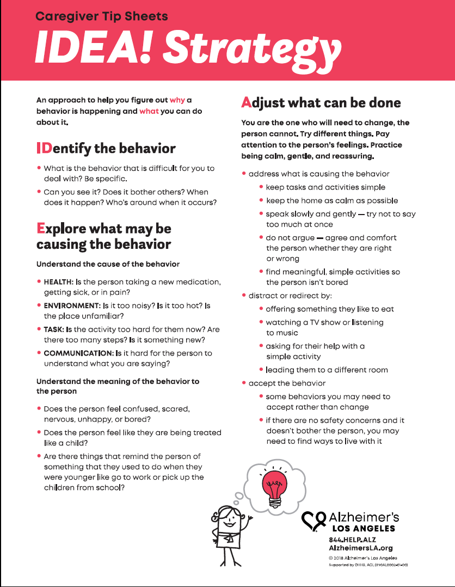
Caregiver Tip Sheets
Anger
Anxiety
Bathing
Communication
Depression
Driving
Eating
Getting Lost
Hallucinations
Keeping Home Safe
Medications
Paranoia
Repeating
Resistance
Sleeping
Sundowning
Toileting
Available in: English, Spanish, Japanese, Chinese
Free to download
www.Alzheimersla.org/caregiver-tip-sheets
‹#›
Notes:
We’ll give you a handout to take with you so you remember all the things we’ve covered today. but there are many resources available. Would you like to receive these kinds of resources via text? If so please write your cell phone number in today’s sign-in sheet.
We ask that you give IDEA! a try so you know what may be helpful and so you have more options to use in your work day. This may not come naturally, but it also is not that hard. It just means you have to be ready to try something new when you see your resident is having trouble. Next time we meet, we’ll talk about how this worked for you.
‹#›

Slide 14

Thank You!
Notes:
We want to thank Alzheimer’s Los Angeles for IDEA!. They worked with us to bring this training to you today. Please make sure to take the hand-out and practice IDEA!
Good luck!
‹#›

