Slide 1

WELCOME
TO
AGE-FRIENDLY STRATEGIES
FOR
NURSING HOME CNA’S
MODULE 2

Slide 2



Funding Disclosures
Derived from the work of Alzheimer’s Los Angeles and partners under ACL grant #90ADPI0024-01-00
This project is/was supported by the Health Resources and Services Administration (HRSA) of the U.S. Department of Health and Human Services (HHS) under grant number U1QHP28740, Geriatrics Workforce Enhancement Program for $3.5 million. This information or content and conclusions are those of the author and should not be construed as the official position or policy or, nor should any endorsements be inferred by, HRSA, HHS or the U.S. Government.
Notes:
This slide shows that we have funding from HRSA, part of Health and Human Services and the program is called GWEP.
We are a partner with the Keck School of Medicine, Department of Family Medicine who developed this program.
The modules we are teaching today are based on work from Alzheimer’s Los Angeles.

Slide 3


Age-Friendly Nursing Home Care Review
DID YOU GET A CHANCE TO PRACTICE WITH YOUR RESIDENT?
WHAT DID YOU LEARN FROM YOUR RESIDENTS ABOUT “WHAT MATTERS” TO THEM?
DID ANYTHING SURPRISE YOU ABOUT WHAT YOU LEARNED?
Notes:
Read slide: 5 minute discussion (for participant who attended first session)

Slide 4




IDEA!
Responding to Difficult Behaviors
Notes:
In today’s training module I will be showing you a strategy that will help you to respond to difficult behaviors that your residents may show. It takes some practice, but once you learn this, you can use it over and over to help you figure out what YOU can do to both get your work done and keep your residents safe and comfortable. We have also heard from CNAs that this strategy also helps save time because residents are more cooperative.
The strategy is called IDEA! And was provided to us from Alzheimer’s Los Angeles. They teach family caregivers to use the strategy and it works!

Slide 5
What is Dementia?
Progresses over time
Impairment in memory & at least one other area of cognition
Effects Instrumental ADL
Medical diagnosis, requires tests to rule out other causes
Notes:
Before we jump in with IDEA! Let’s learn a little bit more about dementia.
Here are some basic ideas about Dementia.
first, it is a disorder that we cannot cure and progresses
It usually affect memory first and then other areas of thinking (here we call thinking “cognition”)
It makes it difficult for residents with dementia to do everyday activities - called ADLs
This is a medical condition that requires tests to diagnose. This is important because we want to make sure it is not something else that could look like dementia but really be a condition that is treatable.

Slide 6
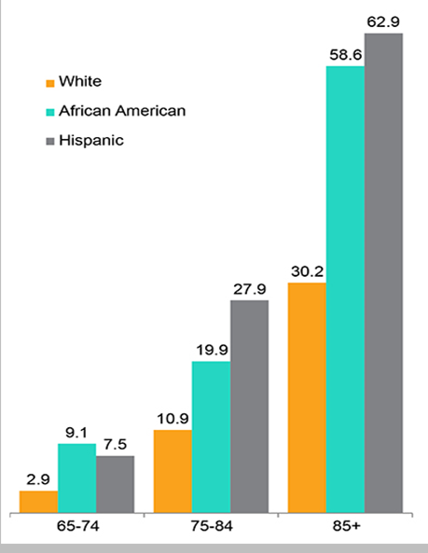
Incidence of Dementia
by Age
Proportion of People
Age 65 and Older with Alzheimer's and other Dementias
Notes:
This slide shows that dementia becomes much more common as people age. You can see that people aged 65 - 74 less than 10% have dementia, but by the time they are over 85 it is well over half.
It also shows that across the board, people of color have a higher rate of dementia but we are not sure why that is.

Slide 7
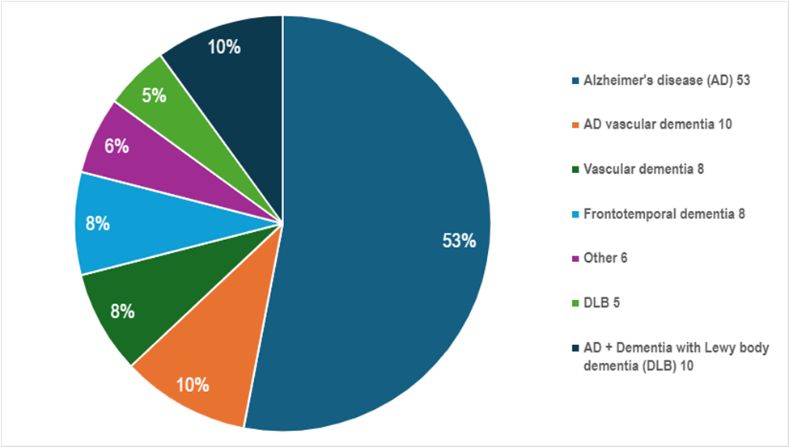
Dementia is a syndrome with many types
Notes:
This slide shows all of the different types of dementia. You can see that more than half are due to Alzheimer’s disease. This is just one type but is the most common.

Slide 8
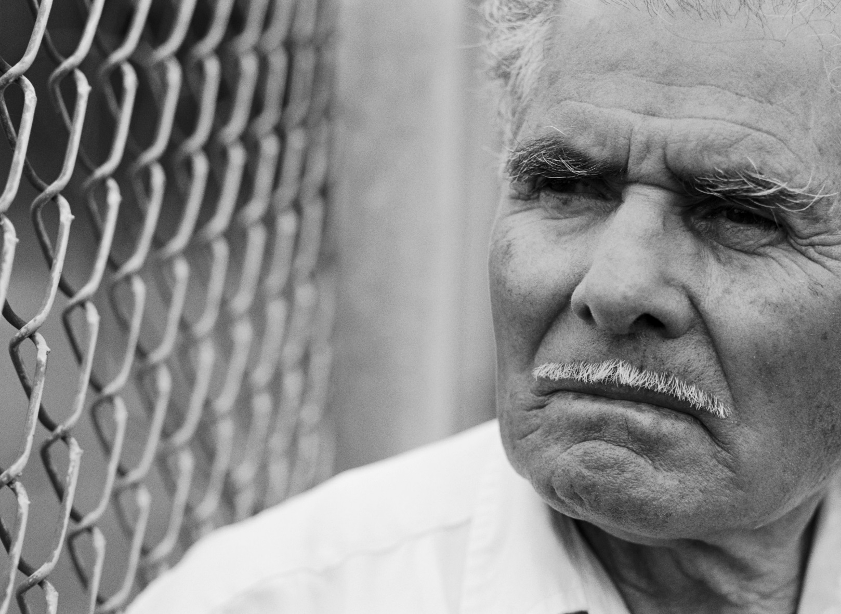
A resident with dementia may…
Hallucinate
Sundown
Hit
Repeat questions
Yell
Worry
Agitation
Aggressive
Paranoia
Refuse Care
Get lost
Wander
Notes:
Unfortunately, residents with dementia often behave in ways that are confusing, don’t make sense to us, disrupt activities, or get in the way of caregiving.
It’s often difficult to figure out why they are behaving this way.
What are some other behaviors you have experienced with your residents that are challenging?
Apathy
Anxiety

Slide 9

Understanding behavioral symptoms of dementia will require you to be a detective
Why are they
behaving like
this?
What are they
telling you?
Is something
wrong?
What do
they want or
need?
Notes:
IDEA! Is a strategy to use with residents who have dementia, which is a disorder that most but not all residents in nursing homes have.
When it comes to caring for a resident living with dementia, we have to be detectives because we need to determine the causes of problem behaviors. When you see that SOMETHING is CAUSING DISTRESS for your resident, put on your detective hat to figure out what is causing the distress and how to effectively deal with it.

Slide 10

IDEA! A 3-Step approach to help you figure out what’s wrong and what you can do to help
IDentify
Identify specific challenges
Explore
  Understand the causes and triggers
Adjust
  Problem solve
Notes:
The IDEA! Approach is a tool that all caregivers can use. It’s a 3-step process.
Identify the behavior
Explore the cause and meaning
Adjust to solve the problem
We’ll go through Identifying and exploring in this session.

Slide 11

IDEA! 1: Identify
the behavior
Consider:
Who is this a “problem” for?
Is this behavior causing problems for the resident?
Is this behavior bothering other residents or staff?
Does the behavior interfere with caregiving?
Is it irritating, but something you can ignore?
This Photo by Unknown Author is licensed under CC BY-NC
Notes:
IDENTIFY: This can be a hard concept to understand. It’s important to pick and choose our battles. For example, some people with dementia “shadow”, which means they follow caregivers around. This may be annoying for the caregiver, but is it a problem to be solved? The resident is getting exercise and not causing any harm. But some residents may try to leave the facility, and that can be very dangerous.
Make sure the PROBLEM behavior is really a problem that needs to be fixed because it is
Unsafe for the resident
Bothers or is unsafe for other residents or staff
Interferes with caregiving
If it is just irritating, can you safely ignore it?

Slide 12

IDEA! Identification of Red Flag Behaviors
Sudden incontinence
Contact your supervisor if you see sudden and unusual changes
Sudden disorientation
Sudden sluggishness
or agitation
Sudden decreased attention
New aggressiveness
‹#›
Notes:
It is also important to note that some behavior changes may signal the need for medical care. Don’t delay, bring these to your supervisor for evaluation.
Examples of sudden and unusual changes that CNA’s should look for include:
Sudden incontinence
Sudden disorientation to time and place
Sudden sluggishness or agitation
Sudden decreased attention
New aggressiveness
‹#›
Understanding Challenging Behaviors

Slide 13

IDEA! 2: Explore
Explore
  Understand causes and triggers
Notes:
Step 2 in the IDEA! is to Explore the causes and triggers.
This step is important because it will help you figure out what you can do to respond.
Take the time to explore and think about why the behavior is occurring.

Slide 14
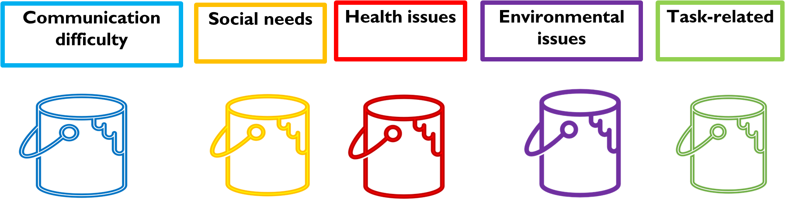
IDEA! 2: Explore
Understand the Causes and Triggers
What is causing this behavior?
Notes:
The causes or triggers to problem behaviors in residents in nursing homes often fall into one of these buckets, so it’s a helpful way to look for triggers.
Triggers can be:
Communication difficulty
Social needs
Health issues
Environmental issues
Task-related issues
We are going to go over each of these buckets of triggers.

Slide 15


IDEA! 2: Explore: Communication Triggers
Is the resident:
able to understand you?
able to speak or find the words?
speaking a different language?
Communication difficulty
Notes:
Dementia can cause communication challenges. It may be difficult for the resident to understand you or to express themself. Sometimes, residents will go back to speaking their first language. Sometimes residents will become agitated when they cannot get out the words they want to say so you can understand them. Some residents stop talking very much and only communicate through their behaviors.

Slide 16

IDEA! 2: Explore: Social Needs
Difficult Behaviors that may indicate
a need for Social Connection:
Shadowing
Pacing
Entering others’ rooms
Reaching out to touch
Crying
Social Needs
Notes:
Some difficult behaviors show us that the resident wants to connect with another person. Sometimes the problem comes from residents feeling alone and looking for family members or familiar faces. Here are some behaviors that are probably triggered by social needs. There are probably many others.

Slide 17

IDEA! 2: Explore: Health/Physical Triggers
Health issues
Hungry/ thirsty
Infection
Tired
Medication reaction
Pain
Notes:
There are many health or physical issues that can lead to challenging behaviors.
It is important not to dismiss symptoms as “due to the dementia” because there may be a medical cause that needs to be addressed.
Behavior changes may signal delirium, infection, fever, dehydration, malnutrition, constipation. Pain is a frequent trigger for behavioral changes. Medication reactions and interactions can also cause sudden and unusual changes.
If someone shows new or worsening symptoms, point it out to your supervisor who will evaluate and help you figure out what may be causing the problem.
Notice if a resident looks like they are uncomfortable, maybe they are not feeling well or in pain but are not able to tell you.

Slide 18
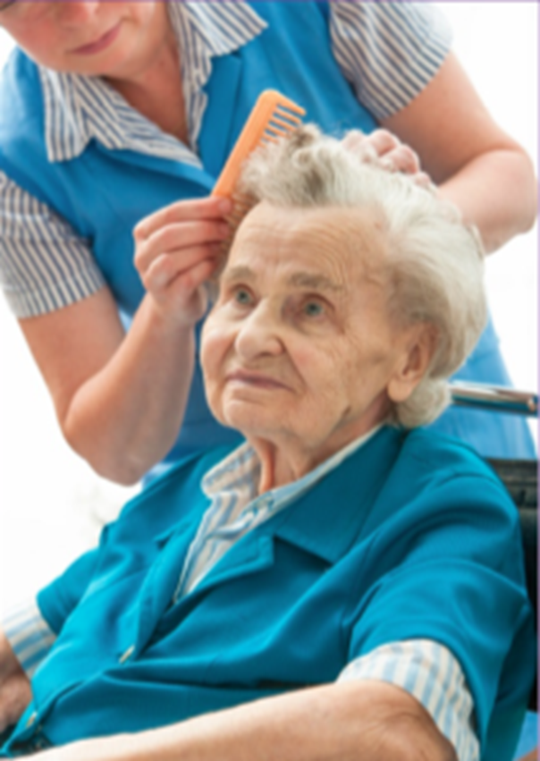


IDEA! 2: Explore: Task Related Triggers
Task related triggers, often tied to personal caregiving:
transfers
bathing
toileting
dressing
eating
Notes:
Read slide: This slide is particularly important for CNA’s. This is often where CNA’s encounter difficulties because tasks can sometimes cause the resident to feel fear and confusion.
Have you experienced this with your residents?
A CNA Story: After doing this training one of the CNA’s tolds us that she was struggling with a resident who was screaming throughout the bathing process. She remembered this training and figured out that this was a task related trigger. This helped her figure out an approach that worked. We’ll talk about this approach later.

Slide 19
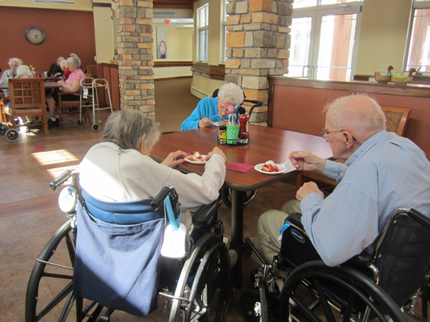

IDEA! 2:
Explore: Environmental Triggers
What is going on in the room?
Look around for clues
Environmental issues
Notes:
Environmental issues are things in the residents physical space that may be triggering distress. This is where you have to be a detective to look around and try to figure out what is in the room or what just happened that may be related to the problem behavior. Here are some ideas:
Is there anyone else there?
What was the resident doing before you entered?
Do you see or hear anything unusual?
Is it too hot? Too cold? Too bright? Too dark?
Look around for clues
What are some things you’ve seen that can trigger problem behaviors in patients?

Slide 20

Case Example:
“I Want to go home!”
Why would someone say, “I want to go home?”
  I want to feel safe
  I want to feel secure
  I want comfort
  I want something familiar
  I want to feel loved
Notes:
Let’s take an example to see how this can work in action.
Imagine a resident who is repeatedly saying “I want to go home” so much that it’s distressing for other residents.
What could this mean?
Do not correct the resident
Saying “But you are home” probably won’t help.
If someone says, “I want to go home!” what could that mean? Maybe:
I want to feel safe
I want to feel secure
I want comfort
I want something familiar
What are some better ways to respond to this emotional need?
Hold the person’s hand
Give the person a hug
Be reassuring
Ask them to tell you something about their mother
Tell them they are safe and loved
All of these are strategies where you ADJUST to the needs of the resident. None are right or wrong, but each could help the resident to be more comfortable.

Slide 21

PUTTING INTO PRACTICE
Putting new ideas into action takes practice:
Identify a difficult behavior in a resident and then decide which bucket it might fall into.
Communication difficulty
Social needs
Health issues
Environmental issues
Task-related
Notes:
Part 1 conclusion - Identifying the problem behavior is not likely going to be hard, but figuring out what bucket it relates to takes more practice.
It will make it easier for you to understand and help your patient feel comfortable.
Can you think of some behaviors that may be hard to put into a bucket?
Over the next few weeks, notice problem behaviors and think about what bucket they fall into.
Practicing this will help you to do it almost automatically. Good Luck!

Slide 22


Thank You!
Notes:
We want to thank Alzheimer’s Los Angeles for IDEA!. They worked with us to bring this training to you today. Please make sure to take the hand-out and practice IDEA! before our next session which will include the next concept of IDEA! (Adjusting activities).
Good luck!

