Slide 2
National Center on Elder Abuse

Slide 3
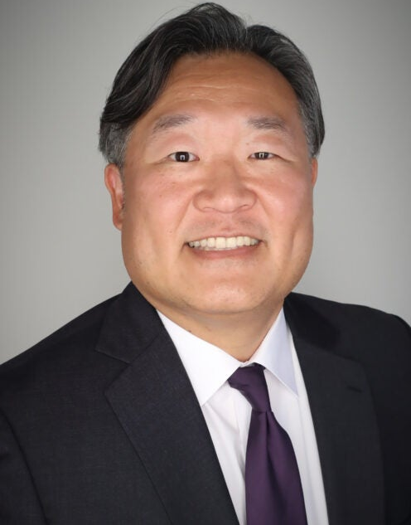
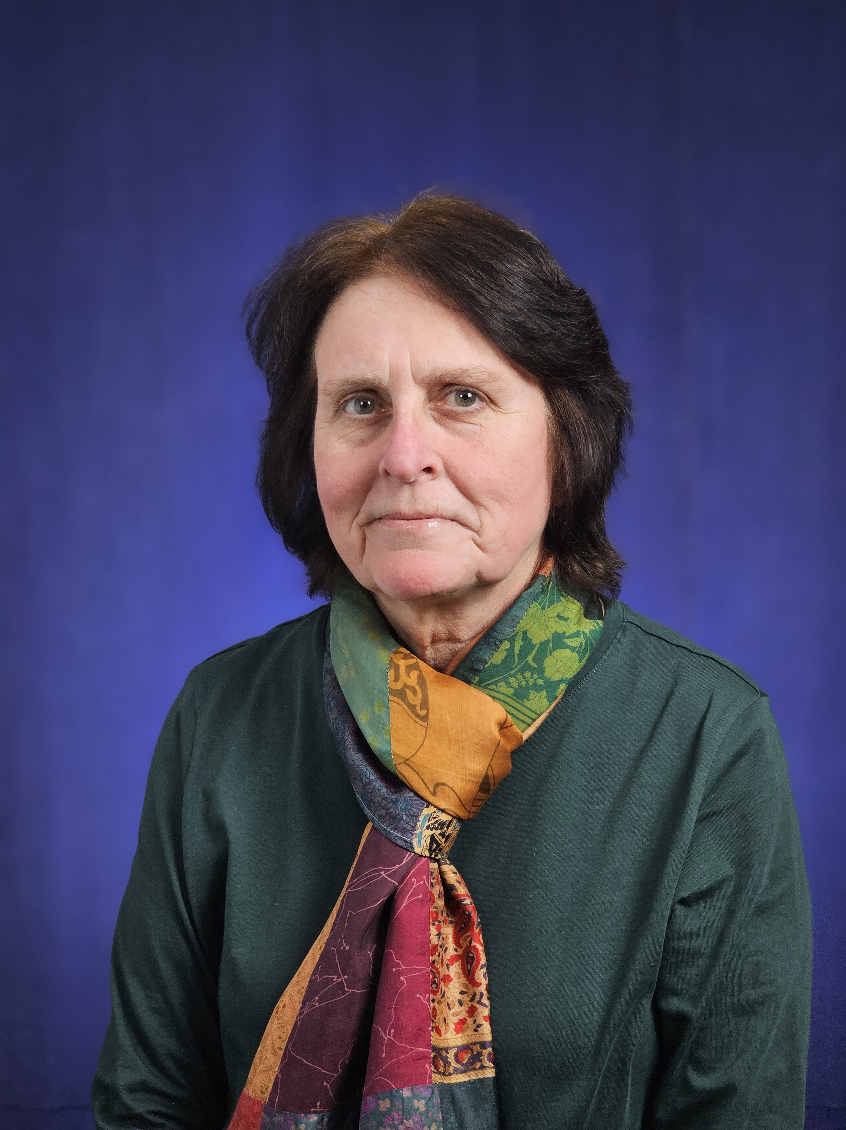
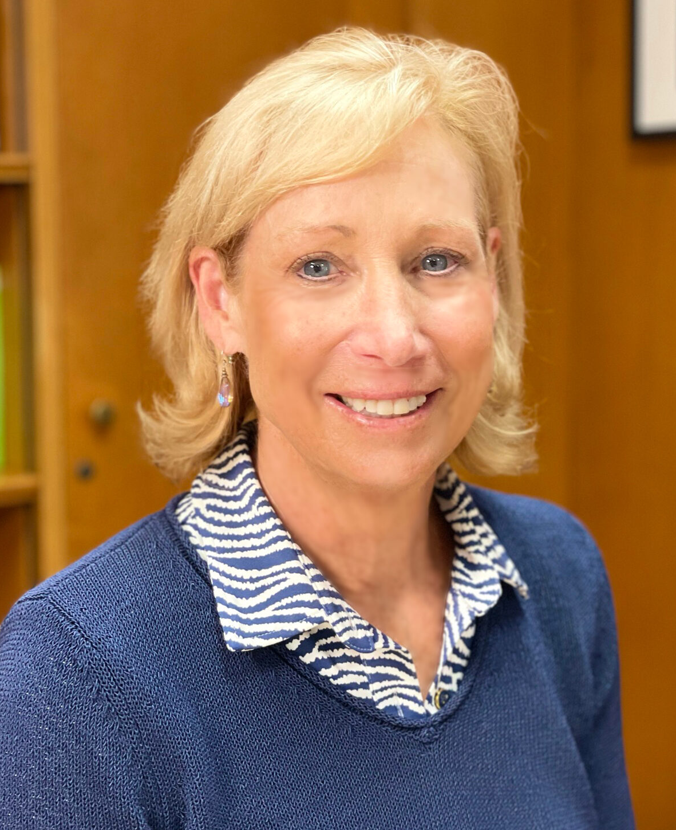
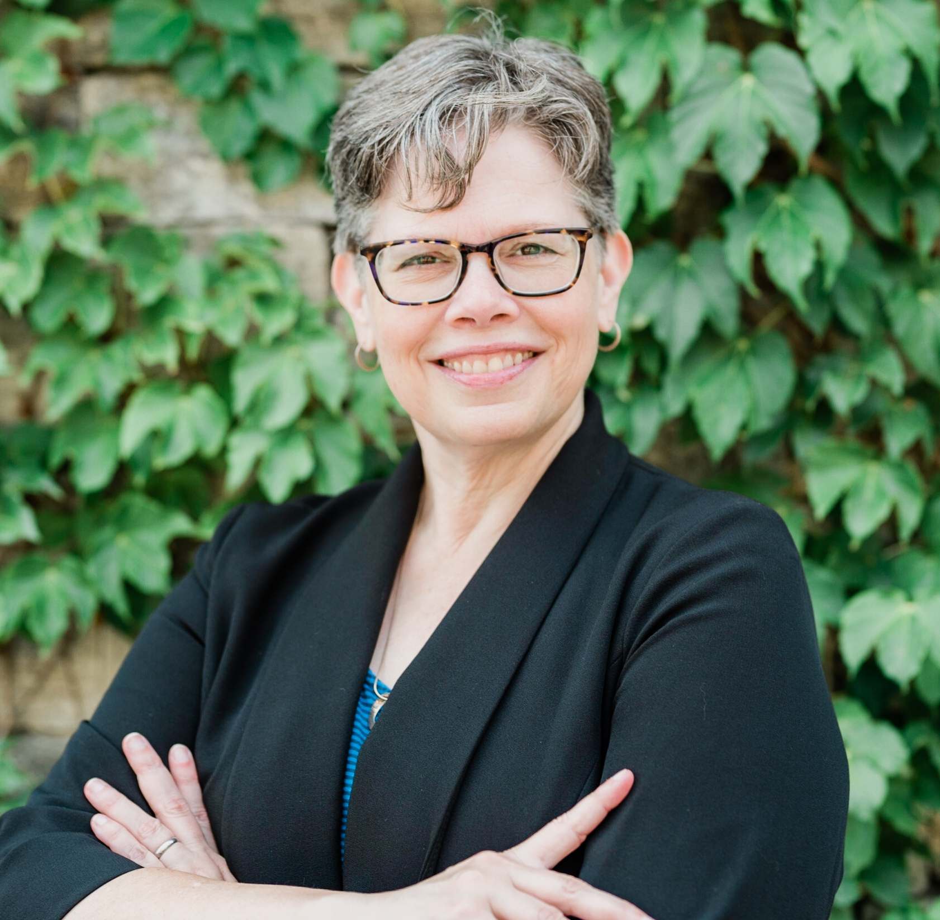
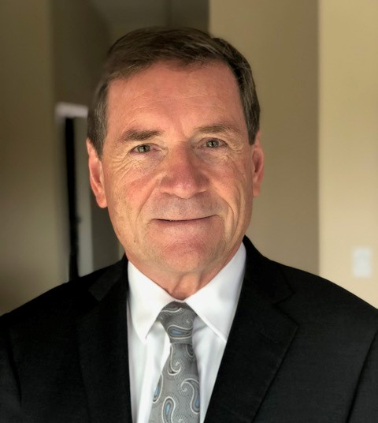
Panelists
Duke Han, PhD
Professor of Psychology, Family Medicine, Neurology, and Gerontology
University of Southern California
Lois C. Greisman
Associate Director
Division of Marketing Practices
Federal Trade Commission
Bonnie Olsen, PhD
Professor of Clinical Family Medicine
University of Southern California
Jennifer Leach
Associate Director
Division of Consumer and Business Education
Federal Trade Commission
Paul Greenwood, LLB, JD
Retired San Diego
Deputy District Attorney

Slide 4
Housekeeping Items
All attendees will enter the meeting in listen-only mode.
Please utilize the Q&A function to submit questions.
To enable the Live Transcript feature, click the button.
Recording & presentation materials will be made available via the National Center on Elder Abuse.
Your feedback matters! After we conclude today’s webinar, please follow the link to complete our survey.

Slide 5
Top Reported Frauds 2024

Slide 6
Top Frauds 2024: Reported Losses & Number of Reports

Slide 7
Top Frauds 2024: Types of Fraud

Slide 8
Top Frauds 2024: Comparison of Reported Loss

Slide 9
Age Differences by Fraud Type
Younger adults (18-59) are much more likely to report losses to…
Online shopping scams
Investment scams
Job scams
Older adults (60+) are much more likely to report losses to…
Tech support scams
Prize, sweepstakes, & lottery scams
Government impersonation scams

Slide 10
Fraud Losses and Reports by Year – Older Adults

Slide 11
Contact Methods Data 2024 – Older Adults
 | Total loss | Loss reports | Median loss
Online fraud | $1,012M | 53K | $395
Phone call | $502M | 20K | $2,210
Text | $183M | 6K | $1,560
Email | $143M | 8K | $1,000
Note: Online fraud includes social media, website or app, & online ad or pop-up
Notes:
Possible messaging:
Online fraud resulted in the highest total reported losses by older adults, but their median reported losses were highest on phone fraud.

Slide 12
Payment Methods Data 2024 – Older Adults
Highest total losses
Bank transfers or payment | $832M
Cryptocurrency | $453M
Cash | $156M
Gift Card | $124M
Check | $121M
Highest % of loss reports
Credit cards | 26%
Gift cards | 16%
Payment app or service | 14%
Debit card | 13%
Bank transfer or payment | 11%
Notes:
Possible messaging:
Bank transfers and payments and cryptocurrency were highest on total reported dollar losses, but credit cards and gift cards were the most frequently reported payment methods.

Slide 13
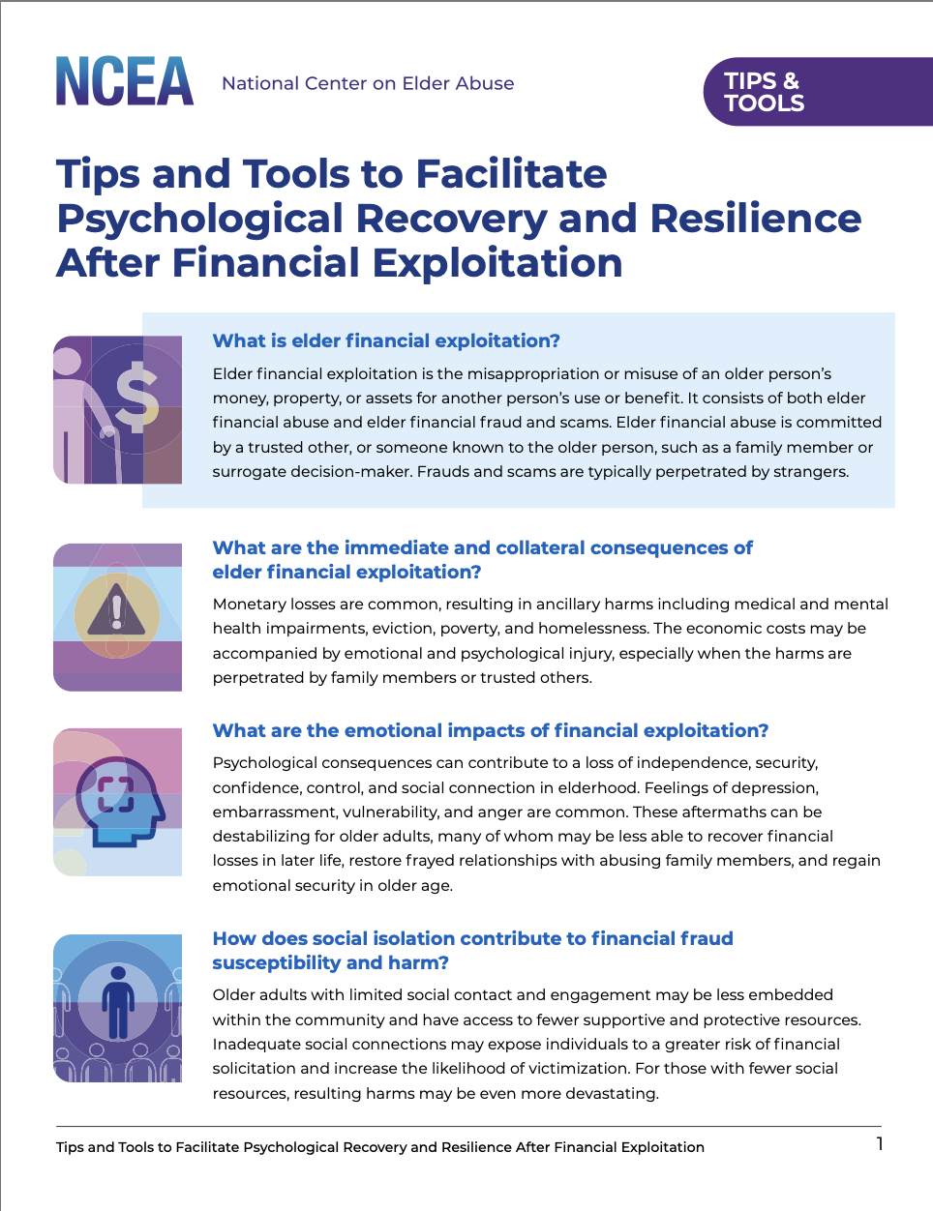
Resources
Tips and Tools to Facilitate Psychological Recovery and Resilience After Financial Exploitation

Slide 14
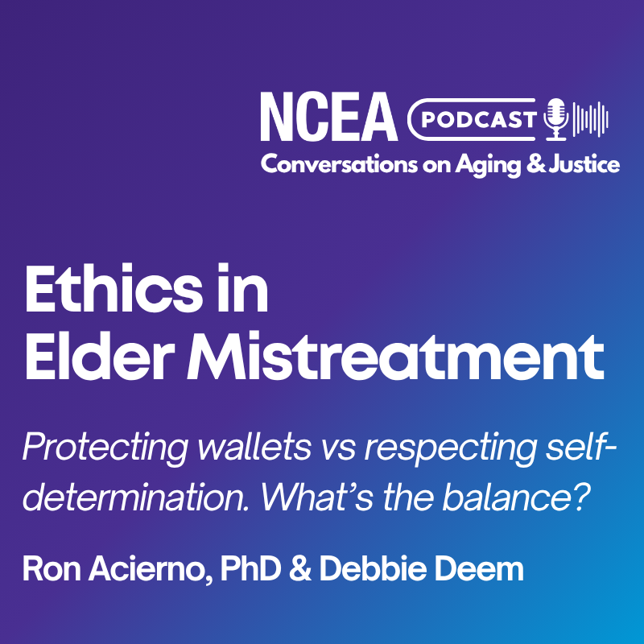
Resources
Podcast: Ethics in Elder Mistreatment – Protecting wallets vs respecting self-determination. What’s the balance?

Slide 15
Free FTC Resources

Slide 16
Fraud Prevention Campaign Designed for Older Adults
Guiding Principles to Reach Older Adults
English
ftc.gov/PassItOn
Spanish
ftc.gov/pasalo
ftc.gov/OlderAdults
fact sheets
bookmarks
online articles
ready-to-go presentations

Slide 17
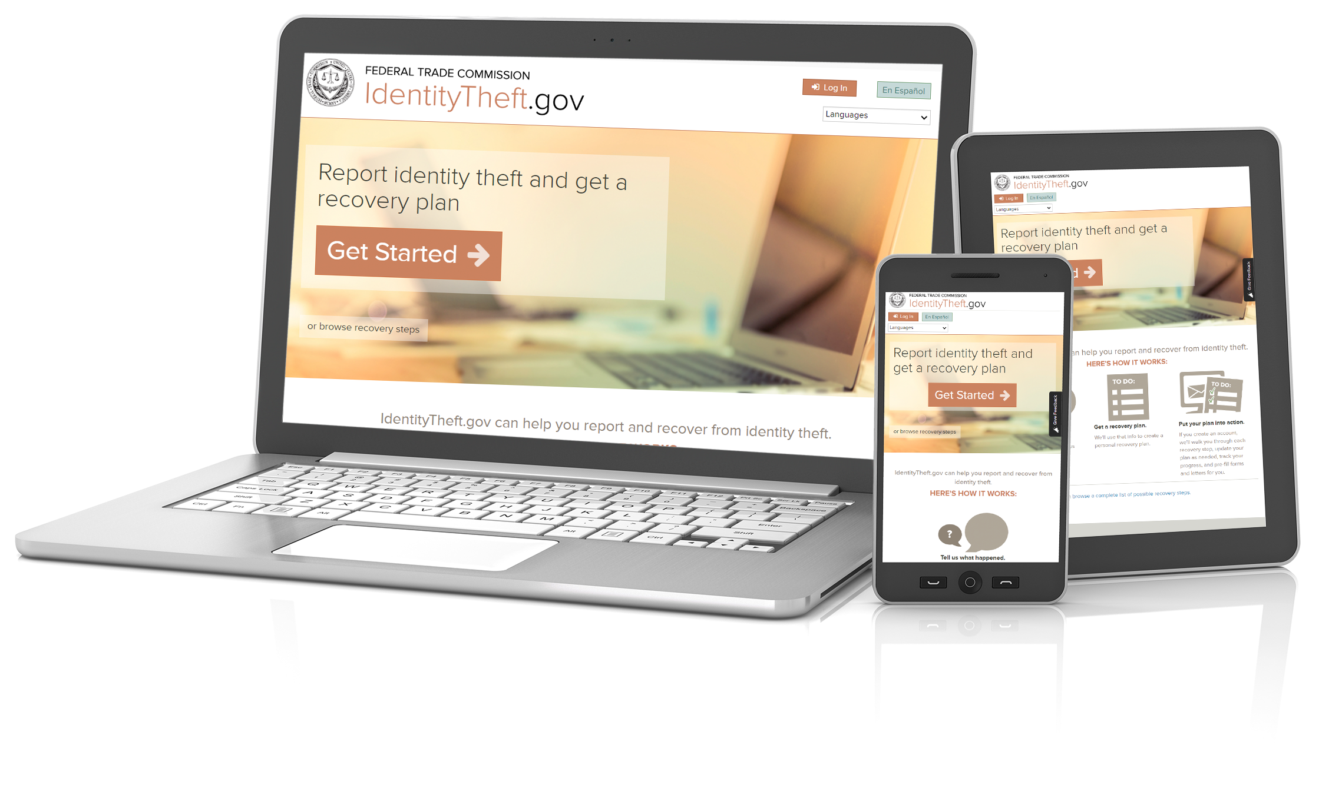
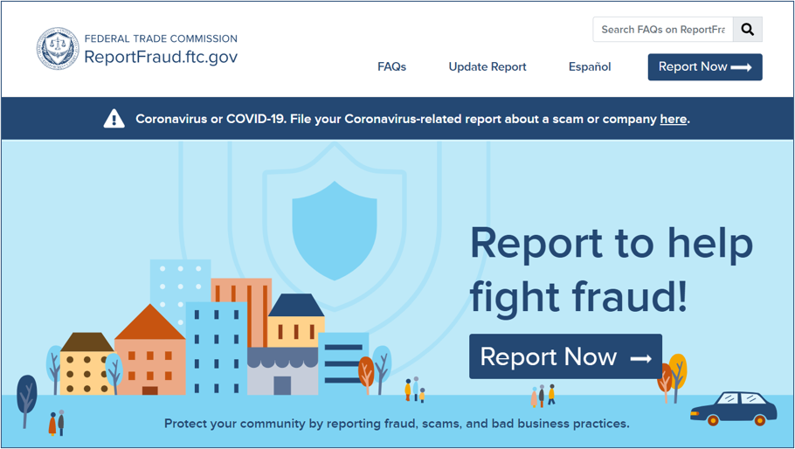
Report Identity Theft and Get a Plan to Recover
Report Fraud to the FTC
English
IdentityTheft.gov
Spanish
RobodeIdentidad.gov
English
ReportFraud.ftc.gov
Spanish
ReporteFraude.ftc.gov
Other Languages: (877) 438-4338, press 3
Other Languages: (877) 382-4357, press 3

Slide 18
Visit the WEAAD Microsite for more resources!
ncea.acl.gov
ncea-info@acl.hhs.gov
855- 500-3537

